Slide 1
Promotion and Tenure Committee Workshop
SEPTEMBER 23, 2024

Slide 2
AGENDA
Introductions
P&T perceptions and outcomes
P&T process and policies
Department heads’ perspectives
Dean’s perspective
University P&T Committee’s perspective
Questions and discussion

Slide 3
P&T Perceptions AND Outcomes
Ron fricker, vice provost for faculty affairs

Slide 4
CLARITY OF TENURE PROCESS
FROM 2023 COACHE FACULTY JOB SATISFACTION SURVEY

Slide 5
CLARITY OF TENURE STANDARDS
FROM 2023 COACHE FACULTY JOB SATISFACTION SURVEY

Slide 6
PROMOTION AND TENURE SUCCESS 2014-2024

Slide 7
P&T PROCESSES AND PRACTICES
Ron fricker, vice provost for faculty affairs

Slide 8
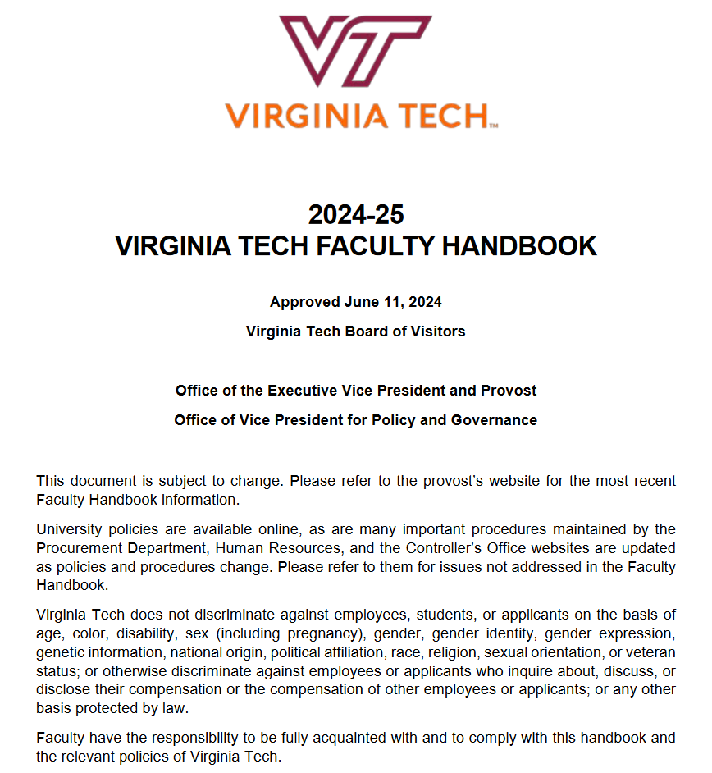
P&T Governed by Faculty Handbook
Section 3.4 in particular:
3.4 Promotion and Tenure
3.4.1 Pre-Tenure Probationary Period
3.4.2 General Expectations for Promotion and Tenure
3.4.3 Departmental or School Evaluation for Promotion and Tenure
3.4.4 College Evaluation for Promotion and Tenure
3.4.5 University Evaluation for Promotion and Tenure
3.4.6 Candidate Notification
See https://faculty.vt.edu/faculty-handbook.html

Slide 9
Important Info on Provost’s Website
Dossier template and preparation guidelines
University-level deadlines for promotion and tenure review
P&T Workshop dates
Historical summary of P&T outcomes
See https://faculty.vt.edu/promotion-tenure.html

Slide 10
PROMOTION AND TENURE PROCESS
Department Level
College Level
University Level
Dossier
P&T Comm
Head
P&T Comm
Dean
P&T Comm
Provost
External Letters
BOV
President

Slide 11
PROMOTION AND TENURE DOSSIER OUTLINE
I. Executive Summary
II. Recommendation Statements
III. Candidate’s Statement
IV. Teaching and Advising Effectiveness
V. Research and Creative Activities
VI. International & Professional Service and Other Outreach & Extension Activities
VII. University Service
VIII. Work Under Review or In Progress
IX. Other Pertinent Activities
See https://faculty.vt.edu/promotion-tenure.html

Slide 12
P&T POLICIES AND PRACTICES
POLICIES
2nd and 4th year progress reviews
Tenure clock extension(s)
Modified duties
Non-mandatory promotion to associate with tenure
See memo dated September 21, 2022
Progress toward promotion to professor
PRACTICES
Mentoring
P&T Workshops
P&T Committee and Heads
Promotion to Associate Professor with Tenure
Promotion to Professor
College-based workshops
Written expectations and standards

Slide 13
Best practices for Mitigating Bias in P&T deliberations
Faculty Affairs is currently developing best practices for mitigating bias in P&T deliberations (see handout for review and comments).
Purpose:
Ensure fairness, objectivity, and inclusivity in P&T evaluations
Mitigate implicit and explicit biases
Align with university values of inclusive excellence
Why It Matters:
Bias can affect decision-making on race, gender, field of study, etc.
Inclusive excellence enriches the intellectual community
Fostering diverse perspectives enhances innovation and academic rigor

Slide 14
SUMMARY OF 2024-25 GUIDELINE CHANGES
Mandatory/nonmandatory checkbox removed from coversheet
Executive summary tables: columns for before and since last promotion or before and since coming to VT, whichever is later
For promotion to professor, increasing expectations that candidate has advised and graduated a terminal-degree graduate student
Tenure-track committee voting restricted to those with tenure
External reviewers asked to self-disqualify if they violate “too close” criteria
Note: “Recent” publications now defined by NSF criteria: within the last four years
Colleges can make this more stringent, meaning increase the length of time
New form for candidates to certify their external reviewer nominees
New memo for external letter guidelines for collegiate faculty

Slide 15
ALSO, SOME REMINDERS
Completeness, clarity, and attention to detail!
Other than for non-substantive corrections, dossiers cannot be changed once (officially) submitted
Dept head and/or dean’s letters used for any updates after submittal
Two progress reviews for promotion to associate and one for promotion to professor
Peer teaching evals: at least two required and they should be thorough (so committees don’t have to just use SPOT scores)
Use of departmental/college Expectation Documents
Candidates must be notified at each stage in the process
Candidates may only be evaluated twice (“two-bites rule”)

Slide 16
P&T PERSPECTIVES
Department Heads
Dean
University P&T Committee

Slide 17
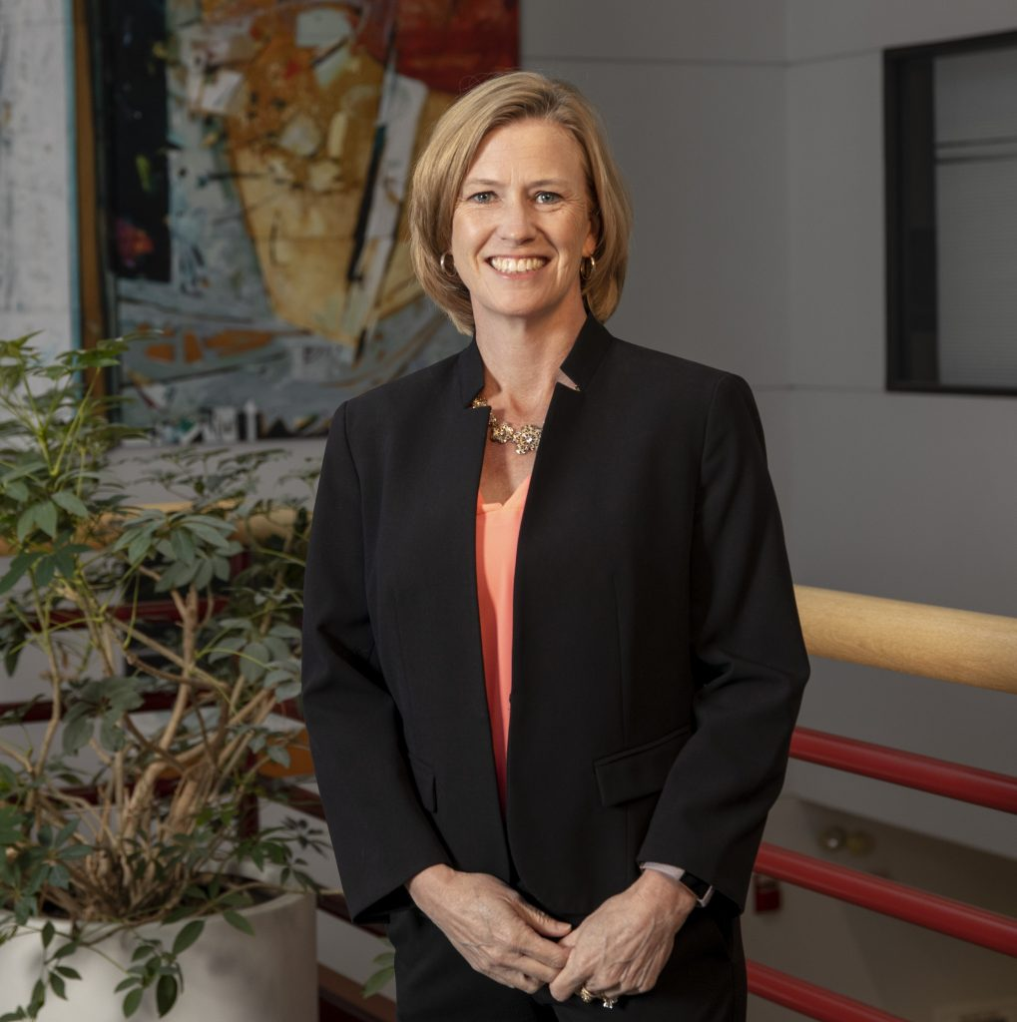
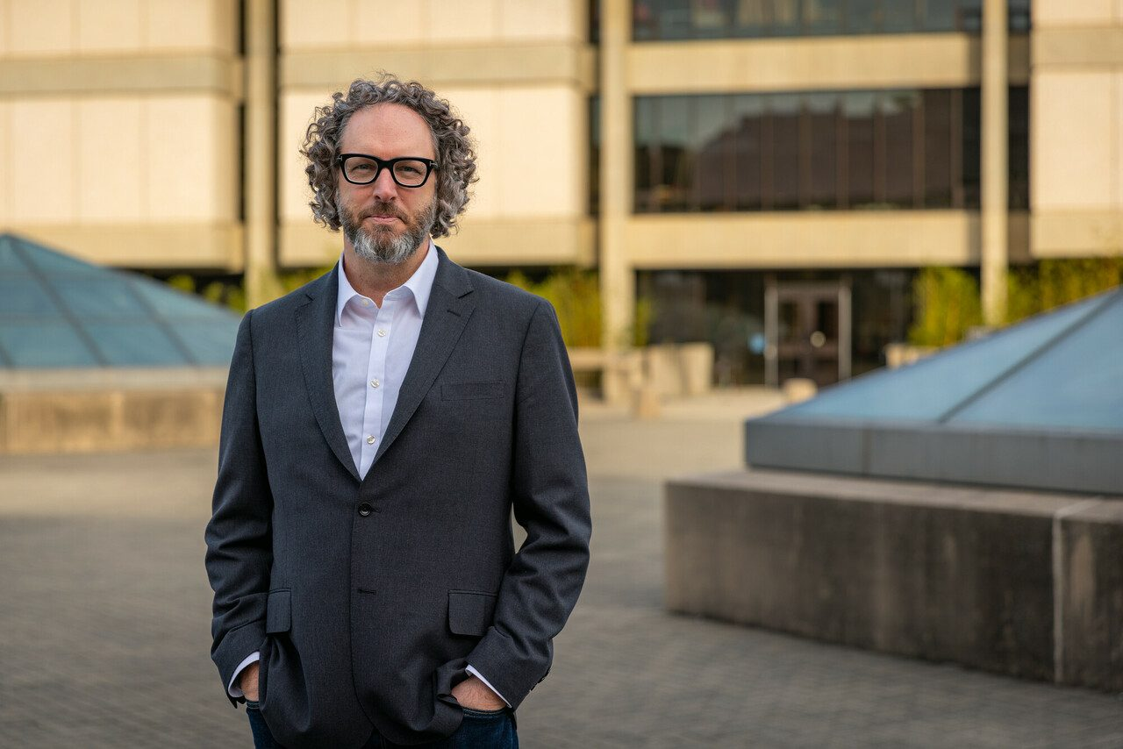
DEPARTMENT HEADS’ PERSPECTIVES
Tracy Rutherford
Agricultural, Leadership, and Community Education
Jim Bassett
School of Architecture

Slide 18
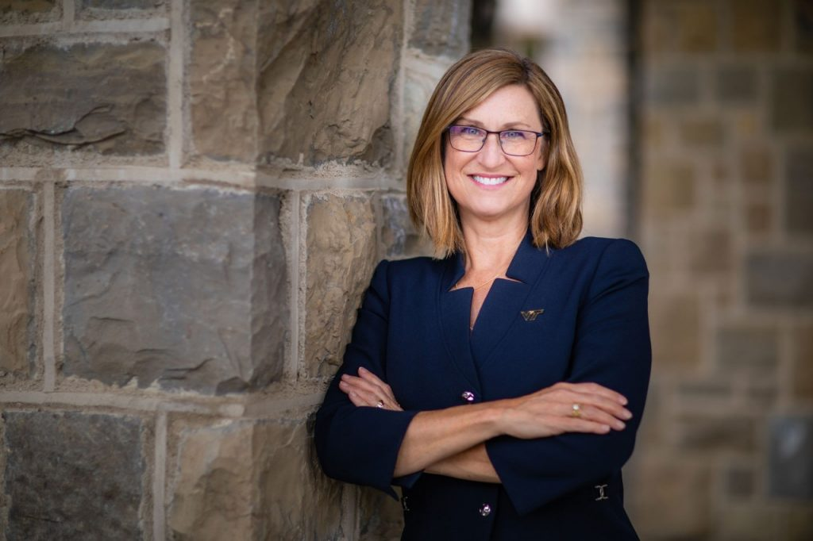
DEAN’S PERSPECTIVE
Julie Ross
College of Engineering

Slide 19
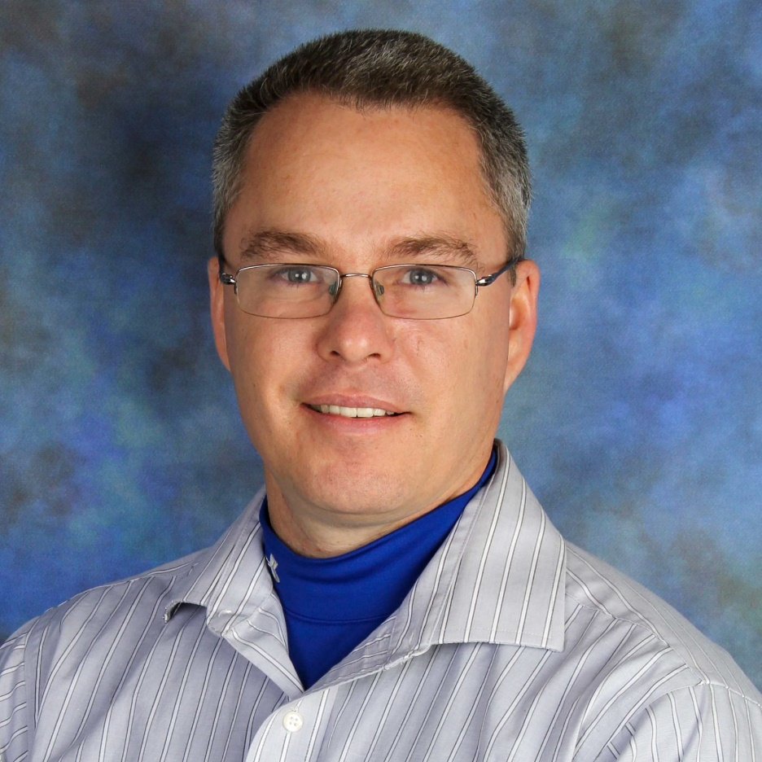
UNIVERSITY P&T COMMITTEE PERSPECTIVE
Shawn Askew
School of Plant and Environmental Sciences

Slide 20
Questions and discussion
Visit the Promotion and Tenure website for more information:
https://faculty.vt.edu/promotion-tenure.html

Slide 21
OTHER RESOURCES

Slide 22
COVID-19 IMPACT CONSIDERATIONS
Faculty COVID statements
Inclusion of cancelled/postponed and/or virtual presentations
SPOT scores for calendar year 2020 optional
Tenure Clock Extensions
Work assignment adjustments
Modified duties
External letter reuse
See https://faculty.vt.edu/promotion-tenure/adaptations-promotion-tenure-process.html

Slide 23
COLLEGE P&T GUIDELINES
College of Agriculture and Life Sciences
College of Architecture, Arts, and Design
College of Engineering
College of Liberal Arts and Human Sciences
College of Natural Resources and the Environment
College of Science
Pamplin College of Business
Virginia-Maryland College of Veterinary Medicine
Virginia Tech Carilion School of Medicine

